Slide 1
Eddie Lynch
Commissioner for Older People for Northern Ireland
National Federation of Pensioners Associations (NFPA)
Dublin 2 May 2019

Slide 2
Overview
Background to Commission
Legal powers and duties
Work of the Office
Corporate plan themes
Investigation into Dunmurry Manor Care Home

Slide 3
About the Commissioner for Older People for Northern Ireland
Commissioner’s office established through devolved Northern Ireland Assembly legislation passed in 2011 – “The Commissioner for Older People Act (Northern Ireland) 2011”
Followed extensive lobbying and campaigning by older people and organisations representing them

Slide 4
About the Commissioner for Older People for Northern Ireland
Principal aim is to be an independent champion who safeguards and promotes the interests of older people
Appointed by The Executive Office
Funded by Department for Communities
15 Staff
Based in Equality House, Belfast

Slide 5
Commissioner’s Legal Powers
Conduct formal and informal investigations
Issue guidance on best practice
Carry out research
Publish information
Provide advice to government

Slide 6
Commissioner’s Legal Duties
Promote positive attitudes towards, and encourage participation by, older people
Review services and legislation that affect the interests of older people
Promote an end to discrimination against older people
Encourage best practice in the treatment of older people
Advise the Assembly, Secretary of State and relevant authorities on matters concerning the interests of older people

Slide 7
Respect, Value, Protect
2016-20 Corporate Plan
Supporting our Ageing Population by promoting positive ageing & ending age discrimination
Better Health and Social Care
Tackling Financial Abuse & Scams & Protecting Older Victims of Crime

Slide 8


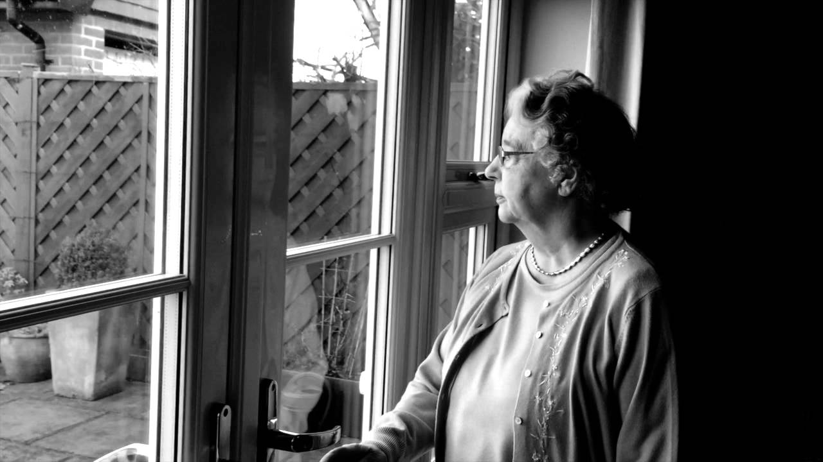

Supporting our Ageing Population by promoting positive ageing & ending age discrimination

Slide 9
Supporting our Ageing Population by promoting positive ageing & ending age discrimination
A programme for government that meets the priorities for older people
An Active Ageing Strategy that is properly resourced and implemented
Legislation to end age discrimination in relation to goods, facilities and services
Tackling social isolation and loneliness – promote policies that support this such as community transport, Senior Smartpass, increase benefit uptake amongst older people

Slide 10
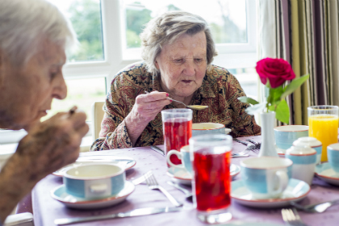
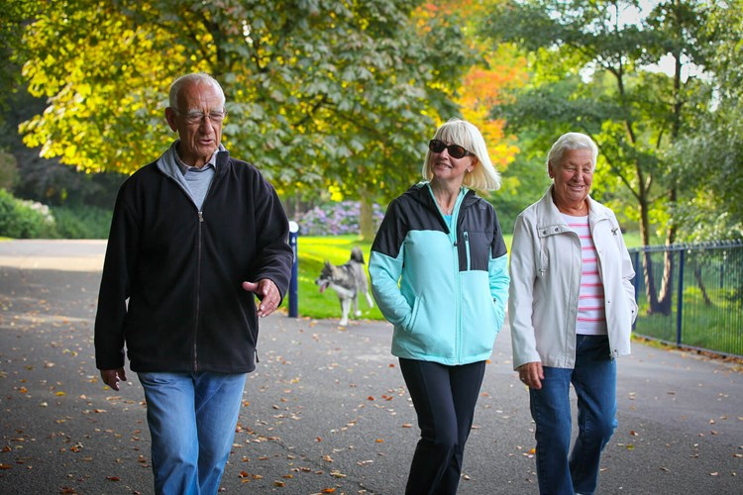
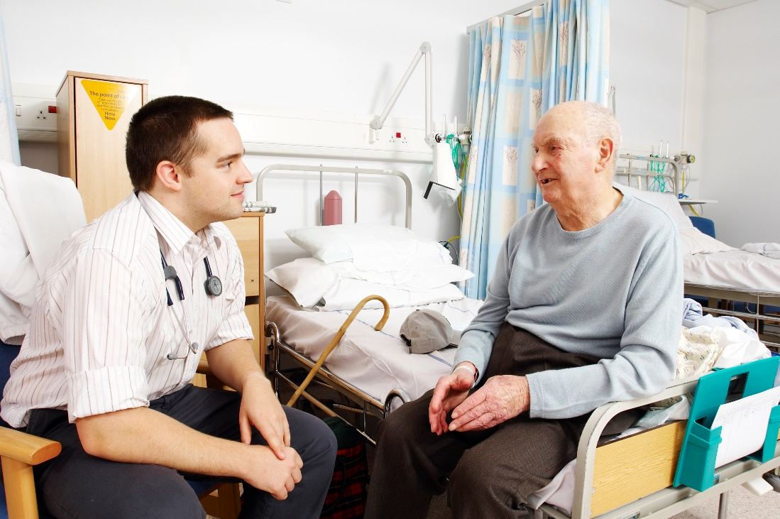

Better Health and Social Care

Slide 11
Better Health and Social Care
Examine concerns in relation to care of older people living in residential and nursing homes
Investigate failures of care in Dunmurry Manor Care Home
Push for reform of Adult Social Care legislation
Pilot a ‘Care and Support Visit’ to 75 year olds

Slide 12


Tackling Financial Abuse & Scams & Protecting Older Victims of Crime

Slide 13
Tackling Financial Abuse & Scams & Protecting Older Victims of Crime
Press for a new Adult Safeguarding Bill for Northern Ireland
Highlight prevalence of Financial Abuse of Older People
Develop and promote Scamwise Partnership messages
Pilot a ‘Support Responder’ Scheme to assist older victims of crime

Slide 14
COPNI Legal Casework
310 Enquiries in past year
  143 general enquiries
  167 cases handled by the Legal Team.
Health and Crime issues most prominent

Slide 15
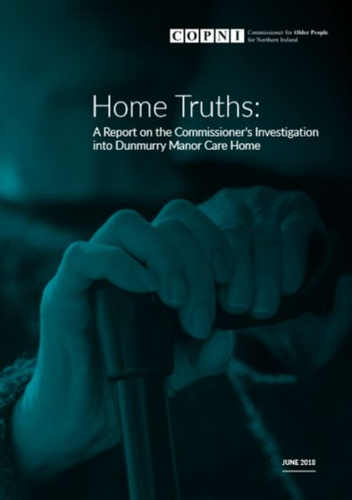
‘Home Truths’ Report June 2018

Slide 16

Investigation
Launched investigation into Dunmurry Manor Care Home in February 2017
1st time COPNI has used investigatory powers under its legislation
Followed a number of complaints from family and whistleblowers
Large number of interviews and documentation received
Published ‘Home Truths’ Report – June 2018
Analysing Response from RA’s – June Update

Slide 17
Investigation
Investigated the actions of the following authorities
Dunmurry Manor/Runwood Homes
Department of Health
4 Health Trusts
Regulation and Quality Improvement Authority (RQIA)

Slide 18
Findings & Recommendations - 9 themes
Safeguarding and Human Rights
Care and treatment
Medicines management
Environment and Environmental Cleanliness
Regulation and Inspection
Staff skills/competence/training
Management and Leadership
Complaints and Communication
Accountability and Governance

Slide 19
Investigation Findings
61 Findings
Poor care and treatment
Serious safeguarding issues
Medicines Management issues
Failure of Relevant Authorities to act quickly and comprehensively
Inhuman and degrading treatment

Slide 20
Investigation Recommendations
59 Recommendations
Seeks systemic changes in the systems
RA’s responded in October
Include calls for
  Adult Safeguarding Bill
  Human rights training
  Changes to inspection methodology
  Performance Rating System

Slide 21
Protecting & Safeguarding Older People
Priority for my term
Health and Social Care
Crime
Practical support
Policy and practice changes
Need for legislative changes
Need for collaboration and effective working across all relevant bodies
Notes:
The findings of my report show that a high level of older people in Northern Ireland have experienced scams and/or cold calls.
Whilst the report provides an indication of the number of older people who have fallen victim to a scam, the actual figure could be even higher. This is because many older victims of scams don’t report their experience due to feelings of shame and embarrassment.
Worryingly, those who do fall victim to a scam are more likely to be targeted again. It also appears that people who are targeted by cold callers are statistically more at risk of being the victim of burglary so this further highlights the seriousness of this problem.

Slide 22
Thank you

